Slide 1
Chapter 12 – Discriminant Analysis
Data Mining for Business Analytics in R
Shmueli, Bruce, Yahav, Patel & Lichtendahl
© Galit Shmueli and Peter Bruce 2017 rev. 12/4/19

Slide 2
Discriminant Analysis: Background
A classical statistical technique
Used for classification long before data mining
Classifying organisms into species
Classifying skulls
Fingerprint analysis
And also used for business data mining (loans, customer types, etc.)
Can also be used to highlight aspects that distinguish classes (profiling)
© Galit Shmueli and Peter Bruce 2017
Notes:
‹#›

Slide 3
Small Example: Riding Mowers
Goal: classify purchase behavior (buy/no-buy) of riding mowers based on income and lot size
Outcome: owner or non-owner (0/1)
Predictors: lot size, income
© Galit Shmueli and Peter Bruce 2017
Notes:
‹#›

Slide 4
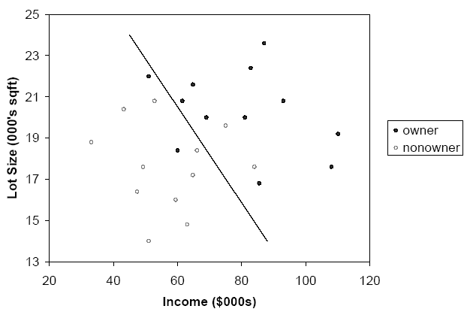
Can we manually draw a line that separates owners from non-owners?
© Galit Shmueli and Peter Bruce 2017
Notes:
‹#›

Slide 5
Example: Loan Acceptance
In the prior small example, separation is clear.
In data mining applications, there will be more records, more predictors, and less clear separation.
Consider Universal Bank example with only 2 predictors:
Outcome: accept/don’t accept loan
Predictors:
Annual income (Income)
Avg. monthly credit card spending (CCAvg)
© Galit Shmueli and Peter Bruce 2017
Notes:
‹#›

Slide 6
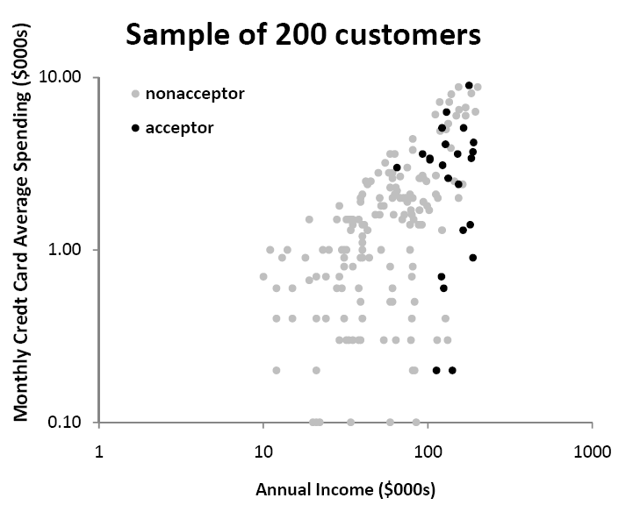
Sample of 200 customers
© Galit Shmueli and Peter Bruce 2017
Notes:
‹#›

Slide 7
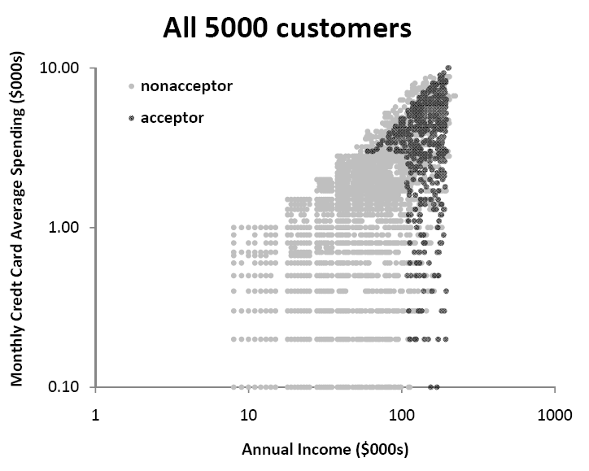
5000 customers
© Galit Shmueli and Peter Bruce 2017
Notes:
‹#›

Slide 8
Algorithm for Discriminant Analysis
© Galit Shmueli and Peter Bruce 2017
Notes:
‹#›

Slide 9
The Idea
To classify a new record, measure its distance from the center of each class
Then, classify the record to the closest class
© Galit Shmueli and Peter Bruce 2017
Notes:
‹#›

Slide 10
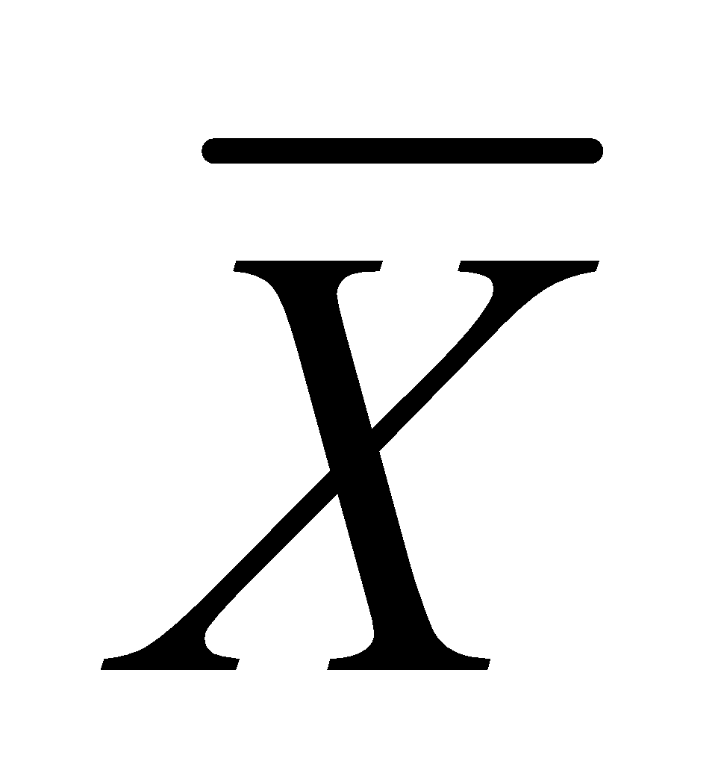
Step 1: Measuring Distance
Need to measure each record’s distance from the center of each class
The center of a class is called a centroid
The centroid is simply a vector (list) of the means of each of the predictors. This mean is computed from all the records that belong to that class.
© Galit Shmueli and Peter Bruce 2017
Notes:
‹#›

Slide 11

Step 1: Measuring Distance – cont.
A popular distance metric is Euclidean Distance (used with KNN). We can use it to measure the distance of a record from a class centroid:
Drawbacks:
Sensitive to scale, variance (can normalize to correct)
Ignores correlation between variables
© Galit Shmueli and Peter Bruce 2017
Notes:
‹#›

Slide 12

Instead, use “Statistical (Mahalanobis) Distance”
transpose (convert column to row)
inverse of covariance matrix S
(p-dimension extension of division)
For a single predictor (p=1), this reduces to a z-score
When p > 1, statistical distance takes account of correlations among predictors (z-score doesn’t)
Notes:
‹#›

Slide 13
Step 2: Classification Functions
The idea is to create classification score that reflects the distance from each class
This is done by estimating “classification functions”, which are a function of the statistical distances.
The estimation maximizes the ratio of between-class to within-class variability
Fisher’s linear classification functions: one for each class. Used to compute a classification score.
Classify a record to class with highest score
© Galit Shmueli and Peter Bruce 2017

Slide 14
In R: library DiscriMiner, function linDA()
library(DiscriMiner)
mowers.df <- read.csv("RidingMowers.csv")
da.reg <- linDA(mowers.df[,1:2], mowers.df[,3])
da.reg$functions
Output
da.reg$functions
Nonowner Owner
constant -51.4214499777 -73.1602116488
Income 0.3293554091 0.4295857129
Lot_Size 4.6815655074 5.4667502174
To classify a case, score it on each function, whichever score is higher is the predicted class
© Galit Shmueli and Peter Bruce 2017

Slide 15
In R: library DiscriMiner, function linDA()
Example:
record #1: income = $60K, lot size = 18.4K
Owner score = -73.16 + (0.43)(60) + (5.47)(18.4) = 53.2
Non-owner score= -51.42+(0.33)(60)+(4.68)(18.4)= 54.48
“Non-owner” score is higher → so (mis)classify as non-owner
Nonowner Owner
constant -51.4214499777 -73.1602116488
Income 0.3293554091 0.4295857129
Lot_Size 4.6815655074 5.4667502174
© Galit Shmueli and Peter Bruce 2017

Slide 16

Converting the function scores to propensities
It is possible to convert classification scores to probabilities of belonging to a class:
P[record i(with measurements x1; x2; :::; xp) belongs to class k] =
The probability is then compared to the cutoff value in order to classify a record

Slide 17
Classification scores, predicted classes
and propensities
da.reg <- linDA(mowers.df[,1:2], mowers.df[,3])
# compute probabilities manually (below); or, use
# lda() in package MASS with predict()
propensity.owner <- exp(da.reg$scores[,2])/(exp(da.reg$scores[,1])+exp(
da.reg$scores[,2]))
data.frame(Actual=mowers.df$Ownership,
da.reg$classification, da.reg$scores,
propensity.owner=propensity.owner)
© Galit Shmueli and Peter Bruce 2017

Slide 18
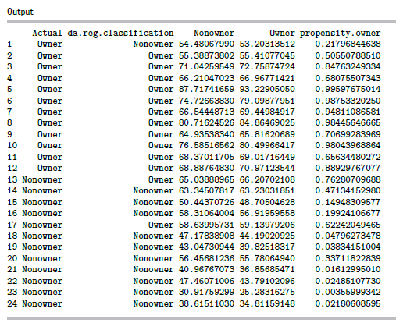
Output
© Galit Shmueli and Peter Bruce 2017

Slide 19
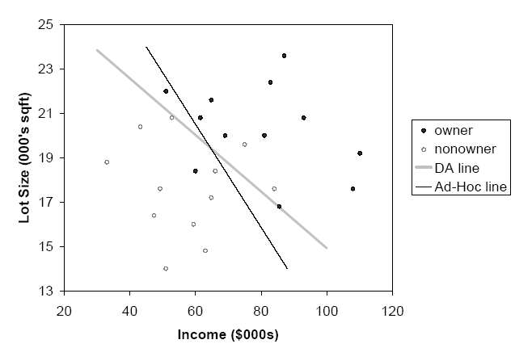
Line from model (plus ad-hoc line)
model
Ad-hoc
© Galit Shmueli and Peter Bruce 2017
Notes:
‹#›

Slide 20
Assumptions & Caveats of Discriminant Analysis
Assumes multivariate normality of predictors
When this condition is met, DA is more efficient than other methods (i.e. needs less data to obtain similar accuracy)
Even when it is not met, DA is robust when we have enough cases in smallest class (> 20) . This means it can be used with dummy variables!
Assumes correlation among predictors within a class is the same across all classes. (Compare correlation tables of each class by eye.)
Sensitive to outliers
© Galit Shmueli and Peter Bruce 2017
Notes:
‹#›

Slide 21
Assessing Predictive Performance
As in other classification methods:
Confusion matrix
Lift
Based on validation data
© Galit Shmueli and Peter Bruce 2017
Notes:
‹#›

Slide 22
Improving Classifications
© Galit Shmueli and Peter Bruce 2017
Notes:
‹#›

Slide 23
Prior Probabilities
If classes are not equally frequent, or their frequency in the sample does not reflect reality, then classification functions can be improved
How?
Incorporate prior (or real) probabilities of class membership:
Add log(p_{j}) to the classification function for class j
P_{j} is probability a case belongs to class j
© Galit Shmueli and Peter Bruce 2017
Notes:
‹#›

Slide 24
Example - Mowers
Sample contains 50% owners, but suppose in population only 15% are owners (i.e. 0.15 probability of being an owner)
Existing classification function constants
Owners: -73.16
Nonowners: -51.42
Adjusted for prior probabilities:
Owners: -73.16 + log(0.15) = -75.06
Nonowners: -51.42 + log(0.85) = -50.58
© Galit Shmueli and Peter Bruce 2017
Notes:
‹#›

Slide 25
Unequal Misclassification Costs
For the two-class (buyer/non-buyer) case, we can account for asymmetric costs of misclassification (C₁, C₂) in same fashion as for unequal prior probabilities
How?
Add log(C₁) and log (C₂) to constants
Often absolute costs are unknown. Instead, use cost ratio:
Set C₁ = 1, C₂ = ratio
Add log (C₂/C₁) to class 2’s constant
© Galit Shmueli and Peter Bruce 2017
Notes:
‹#›

Slide 26
Multiple Classes
Same procedure is used for multiple classes
One classification function for each class
Whichever function has highest value, case is assigned to that class
© Galit Shmueli and Peter Bruce 2017
Notes:
‹#›

Slide 27
Example: Auto Accidents
Outcome: (3 classes)
No injury
Non-fatal injury
Fatal injury
Predictors: Time of day, day of week, weather, type of road, road surface conditions, …
© Galit Shmueli and Peter Bruce 2017
Notes:
‹#›

Slide 28
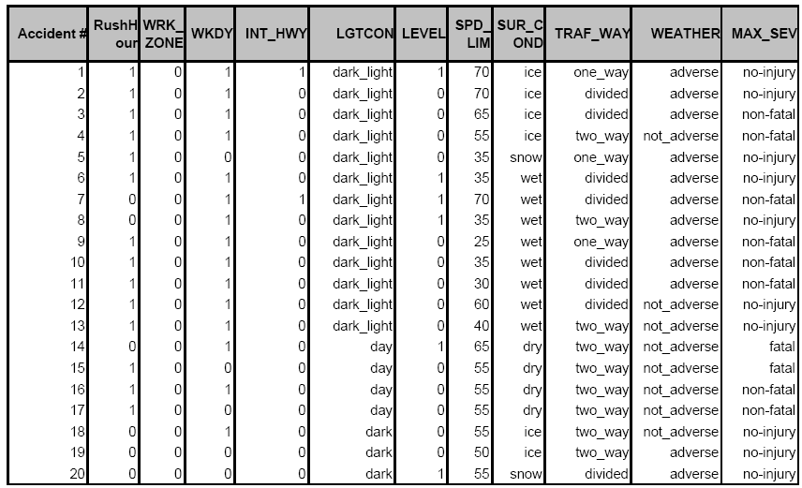
Accident Example: Data Sample
© Galit Shmueli and Peter Bruce 2017
Notes:
‹#›

Slide 29
Code to obtain functions and confusion matrix (training data)
library(DiscriMiner)
library(caret)
accidents.df <- read.csv("Accidents.csv")
da.reg <- linDA(accidents.df[,1:10], accidents.df[,11])
da.reg$functions
confusionMatrix(da.reg$classification,
accidents.df$MAX_SEV)
(data partitioned next, but partitioning code omitted; training partition is henceforth called "accidents.df“, same as full data)
© Galit Shmueli and Peter Bruce 2017
Notes:
‹#›

Slide 30
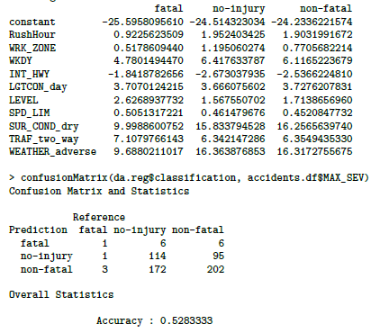
Classification Functions + Confusion Matrix (Training Data)
© Galit Shmueli and Peter Bruce 2017
Notes:
‹#›

Slide 31
Code for obtaining classification scores and propensities (training data)
prob <- exp(da.reg$scores[,1:3])/
(exp(da.reg$scores[,1])+exp(da.reg$scores[,2])
+exp(da.reg$scores[,3]))
res <- data.frame(Classification = lda.reg$classification,
Actual = accidents.df$MAX_SEV,
Score = round(da.reg$scores,2),
Propensity = round(propensity,2))
head(res)
© Galit Shmueli and Peter Bruce 2017

Slide 32
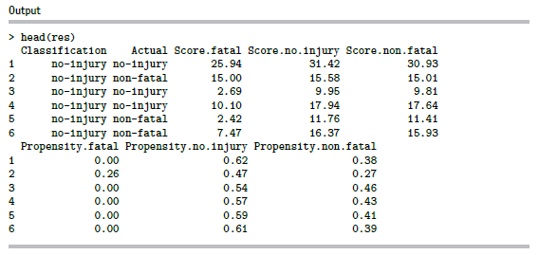
Output – propensities (training data)
© Galit Shmueli and Peter Bruce 2017

Slide 33
Summary
Discriminant analysis is based on measuring the distance of a record from the class centers
The distance metric used is statistical distance, which takes into account the correlations between predictors
Assumptions: equal correlations within each class, and normality (but fairly robust to violation of normality)
Sensitive to outliers (explore the data!)
Classification functions useful for profiling: can order predictors in terms of separating the classes
© Galit Shmueli and Peter Bruce 2017

